Slide 2
C Major Scale – Click to Listen

Slide 3
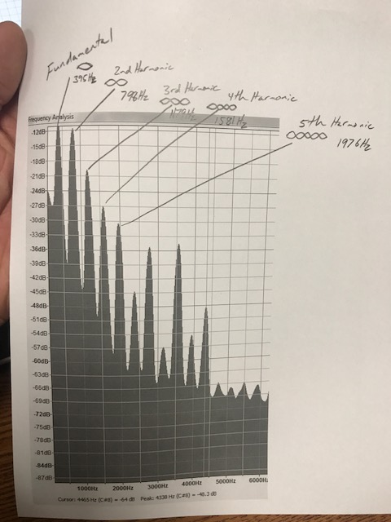
Harmonics

Slide 4
Song
I ran out of time. You must have a song inserted here like the major scale on slide 2.

